Slide 1
Internet Programming And Mobile Programming (Task 1)
By: Group 14

Slide 2
Agenda
Introduction to Mobile Apps
Mobile App Programming Languages
Comparison of Mobile App Development Frameworks
Mobile Application Architecture and Design Patterns
Collection and Analysis of User Requirements for a Mobile Application
Estimating Mobile App Development Cost

Slide 3
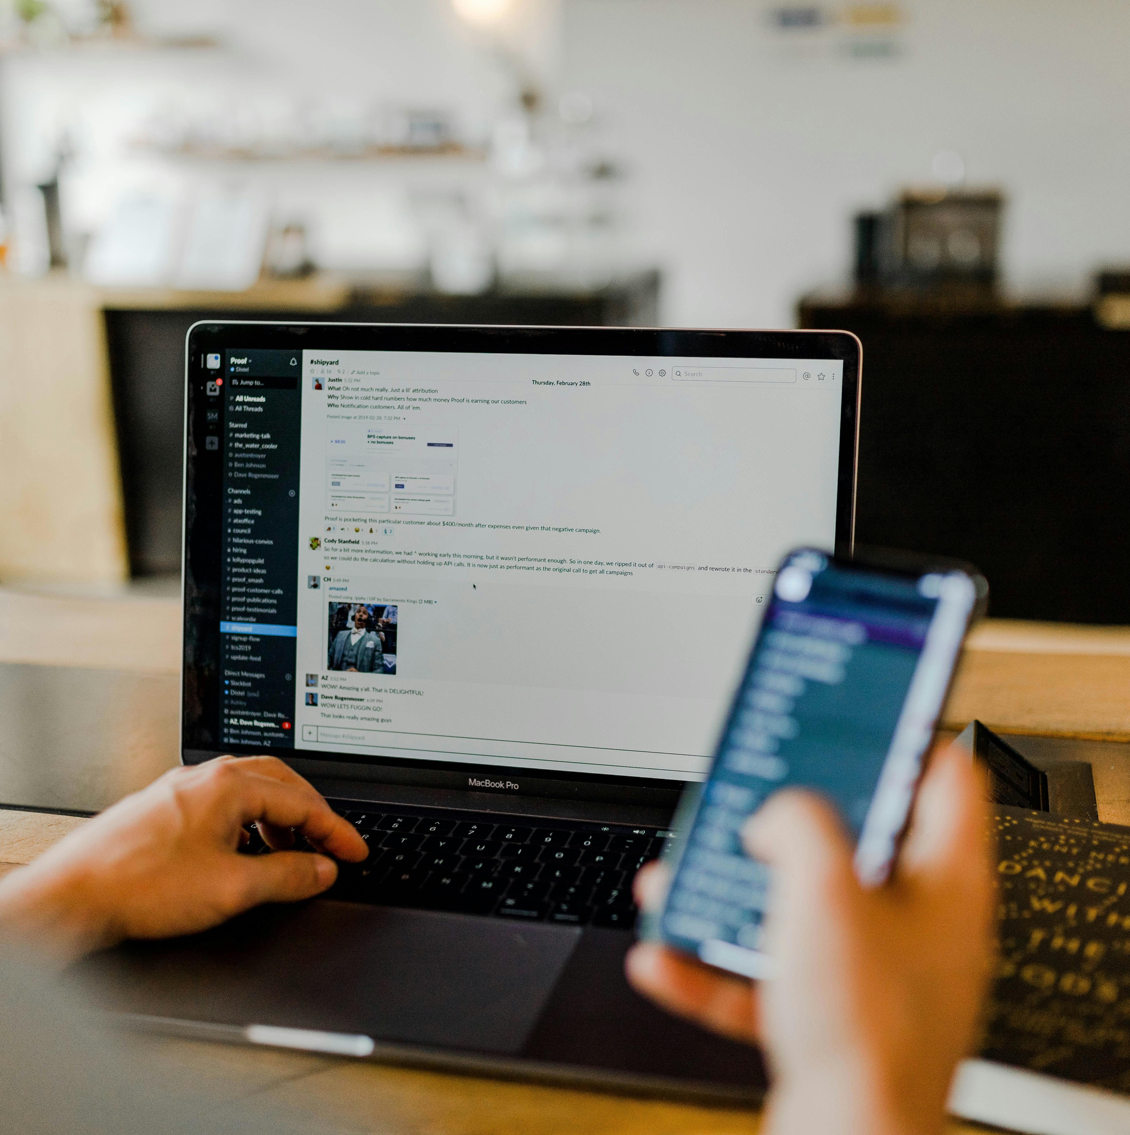
Introduction to Mobile Apps
Native
Web
Hybrid

Slide 4
Comparisons
Aspect | Web | Native | Hybrid
Definition | Adaptive webpages relying on browsers | Created for a single operating system | Designed for multiple platforms
Performance & Productivity | Slower, less intuitive designs | Outstanding performance, engaging UI | Slower, functional UI
Cost & Time | Quick and least expensive | Costly, time-consuming, high maintenance | Lower cost, easier maintenance
Testing | UI, battery, network, ad blockage | Network, screen, compatibility, gestures | Screen, compatibility, gestures, network
Advantages | Multiple platform compatibility, efficient deployment | Intuitive interface, high performance, feature-rich | Market reach, user experience, development time
Examples | Netflix, Google Docs, Basecamp | WhatsApp, Spotify, Pokémon Go | Instagram, Uber, Gmail

Slide 5
Mobile Programming Languages
2 Cross Platform Languages
1 Native Languages
JavaScript (with React)
Dart (with Flutter)
Java
Kotlin
Objective-C
Swift
3 Other Languages
C++
HTML5/CSS3/JavaScript

Slide 6
Comparison of Mobile App Development Frameworks
Framework | Language | Performance | Cost and Time to Market | UI / UX | Complexity | Community Support | Use Cases
Adobe Phone Gap | html/ css/ Js |  |  |  |  | Active | CP
Ionic | html/ css/ Js |  |  |  |  | Strong | CP
Xamarin | C# |  |  |  |  | Robust | CP
React Native | Js |  |  |  |  | Large | CP
Flutter | Dart |  |  |  |  | Growing | CP
Corona SDK | Lua |  |  |  |  | Supportive | 2D games
Mobile Angular | html/ css |  |  |  |  | Active | Web Apps
CP: Cross Platform
Moderate
Good
Excellent

Slide 7
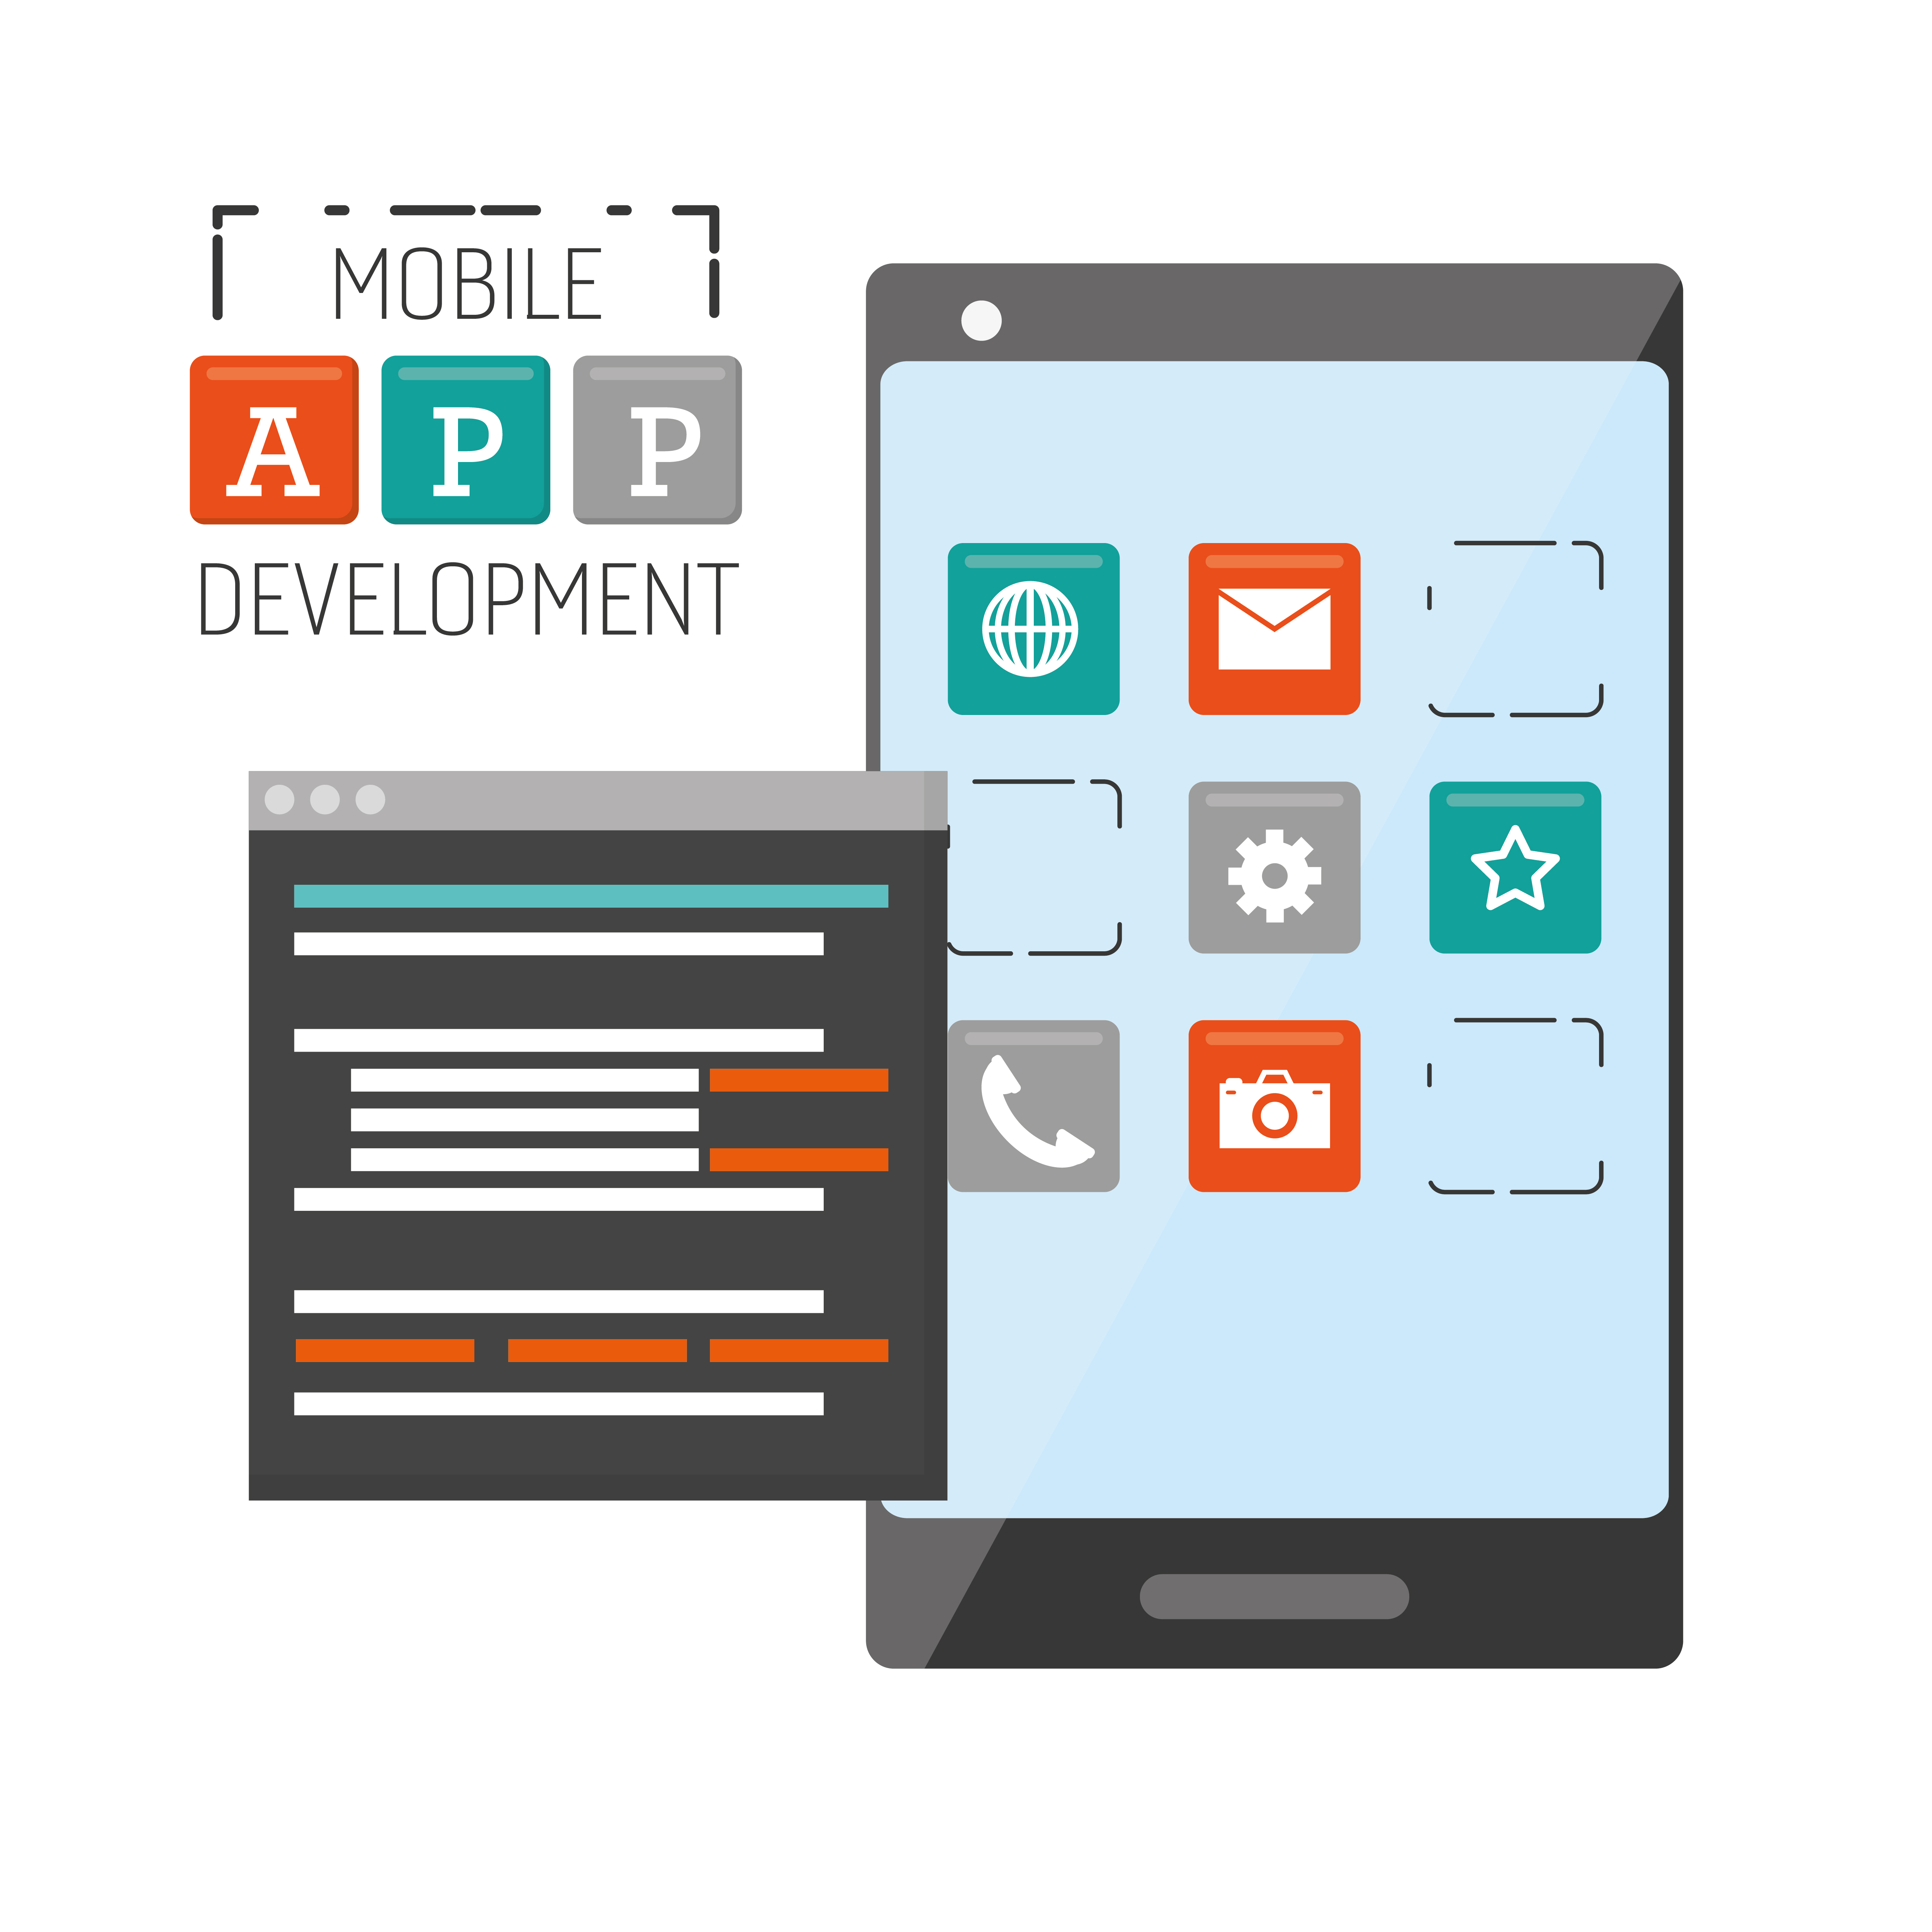
Mobile Application Architecture and Design Patterns
Types of Architectural Design Patterns
Model View Controller (MVC)
Model View Presenter (MVP)
Model View View Model (MVVM)

Slide 8
Mobile Application Architecture and Design Patterns
Why Should I use this?
Using an architecture pattern in mobile development helps organize code, ensures compatibility across different devices, and improves security, making it easier to handle challenges like limited resources and diverse platform requirements.

Slide 9
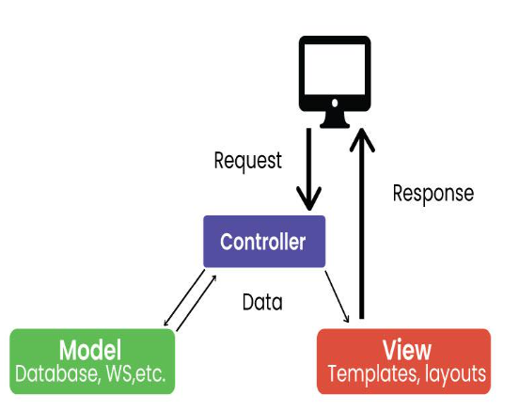
Model-View-Controller
Model: Represents application data and business logic.
View: Displays data to the user.
Controller: Processes user input and controls data flow between Model and View.

Slide 10
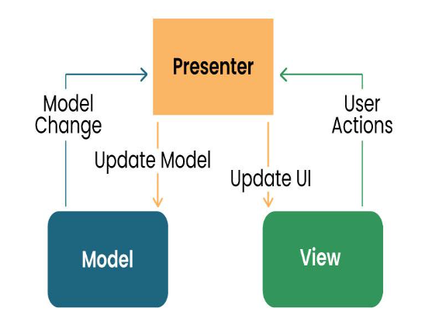
Model-View-Presenter
Model: Manages data and business logic.
View: Represents the user interface.
Designer: Acts as an intermediary processing user input and updating the View and Model.

Slide 11
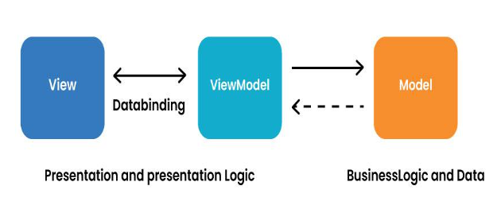
Model-View-ViewModel
Model: Represents data and business logic.
View: Represents the user interface.
ViewModel: Acts as an interface between the Model and the View, which contains the reference logic.

Slide 12
Collection and Analyses of User Requirements for a Mobile Application
" By following these steps and incorporating best practices for requirement engineering, you can effectively collect and analyze user requirements for a mobile application, setting the stage for a successful development process and a product that meets users' needs and expectations. "
Identify Stakeholders
Gather Requirements
Analyse Requirements
Document Requirements
Validate Requirements
Manage Requirements Changes
Iterate

Slide 13
Estimating Mobile App Development Cost
Define Requirements
Choose Platform
Complexity
Design
Development Time
Testing
7. Maintenance
8. Contingency
9. Developer Rates
10. Documentation
11. Marketing and Distribution

Slide 14

References
https://www.geeksforgeeks.org/design-patterns-for-mobile-development/
https://www.linkedin.com/advice/0/how-do-you-use-architecture-pattern-mobile#:~:text=Three%20of%20the%20most%20common,hard%20to%20maintain%20and%20test.
https://www.gurutechnolabs.com/mobile-app-technologies/

Slide 15
Thank you
Github: https://github.com/Langeh03/Group14

